Slide 1
KNOT's Not Only Terminal
Team Nice Penguin

Slide 2






Team Nice Penguin
Minwoo, Cho
Seokhyeon, Yun
TOM
Team Leader Front-end : Console/Reference Back-end : SSH Console
Team Member Front-end : Home
Team Member Front-end : About

Slide 3
SSH Web Console
LINUX Reference
The main production goal of this project is to make it available on the web without the need to install additional programs for SSH communication. In addition, we implemented a system to automatically enter commands by pressing a button instead of just typing commands.
To make it easier for the average user, we've put together a reference that covers basic Linux command usage. It's presented in a tabular format, so it's easy to recognize at a glance and shows groups of commands used in similar situations.
Overview
KNOT's Not Only Terminal
Named in old hacker style, this project offers users a new kind of web SSH terminal.

Slide 4
Single Page Application
HOME
Console
Reference
About
Our page consists of a single piece of HTML, not several separate pieces of HTML.
We used a combination of appropriate JavaScript and display in CSS to ensure that it doesn't take too much time to load during use.
In one HTML
The backend configuration utilized Node.js, while the frontend configuration utilized React, Bootstrap, and Javascript.

Slide 5
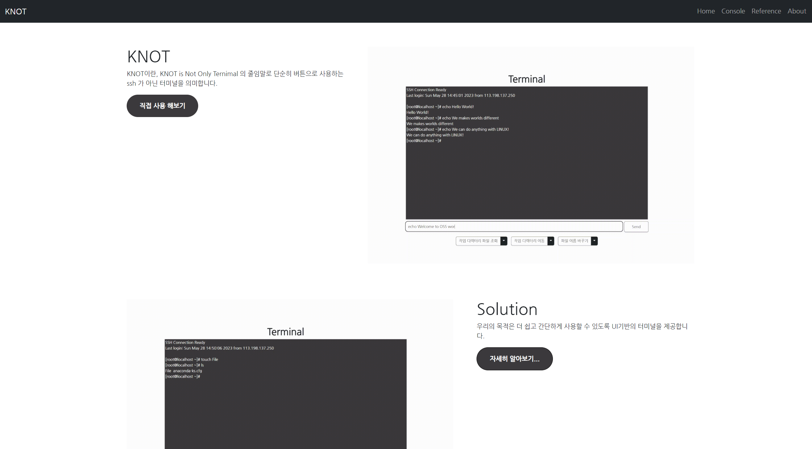
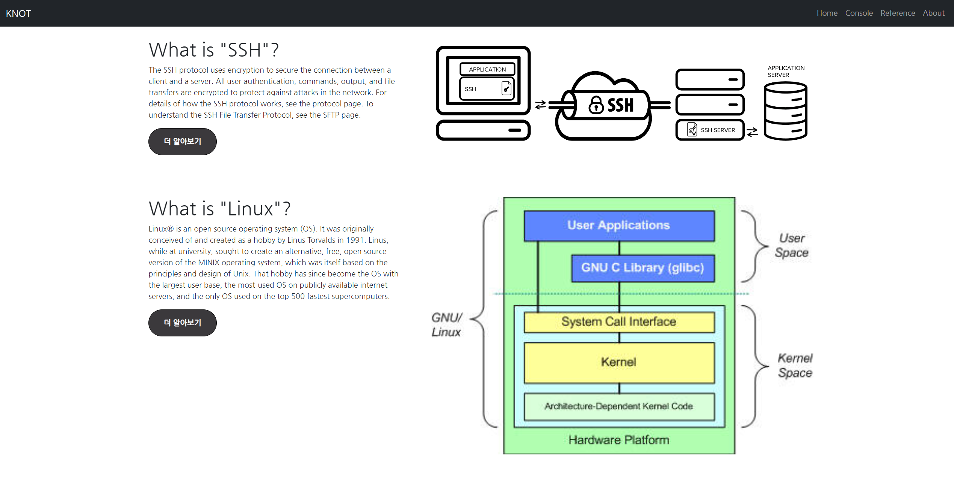
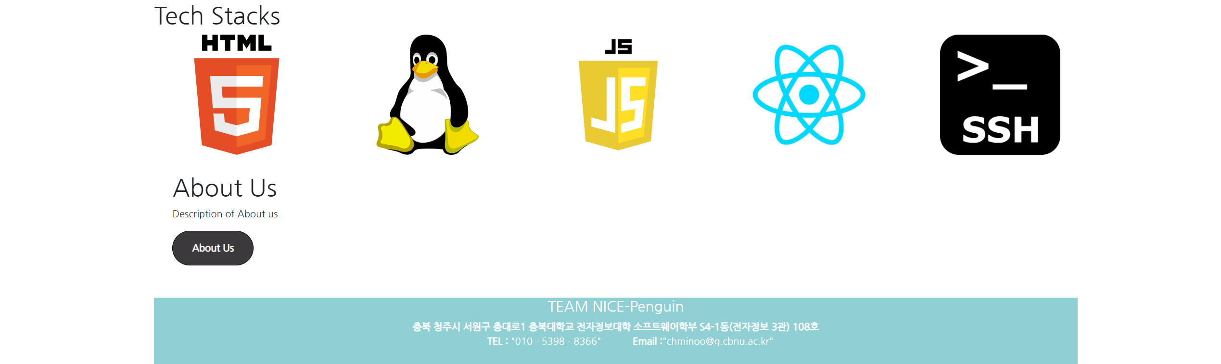
Home
We offer information of our Web Console
We offer information of SSH, LINUX
..and our tech stacks!

Slide 6
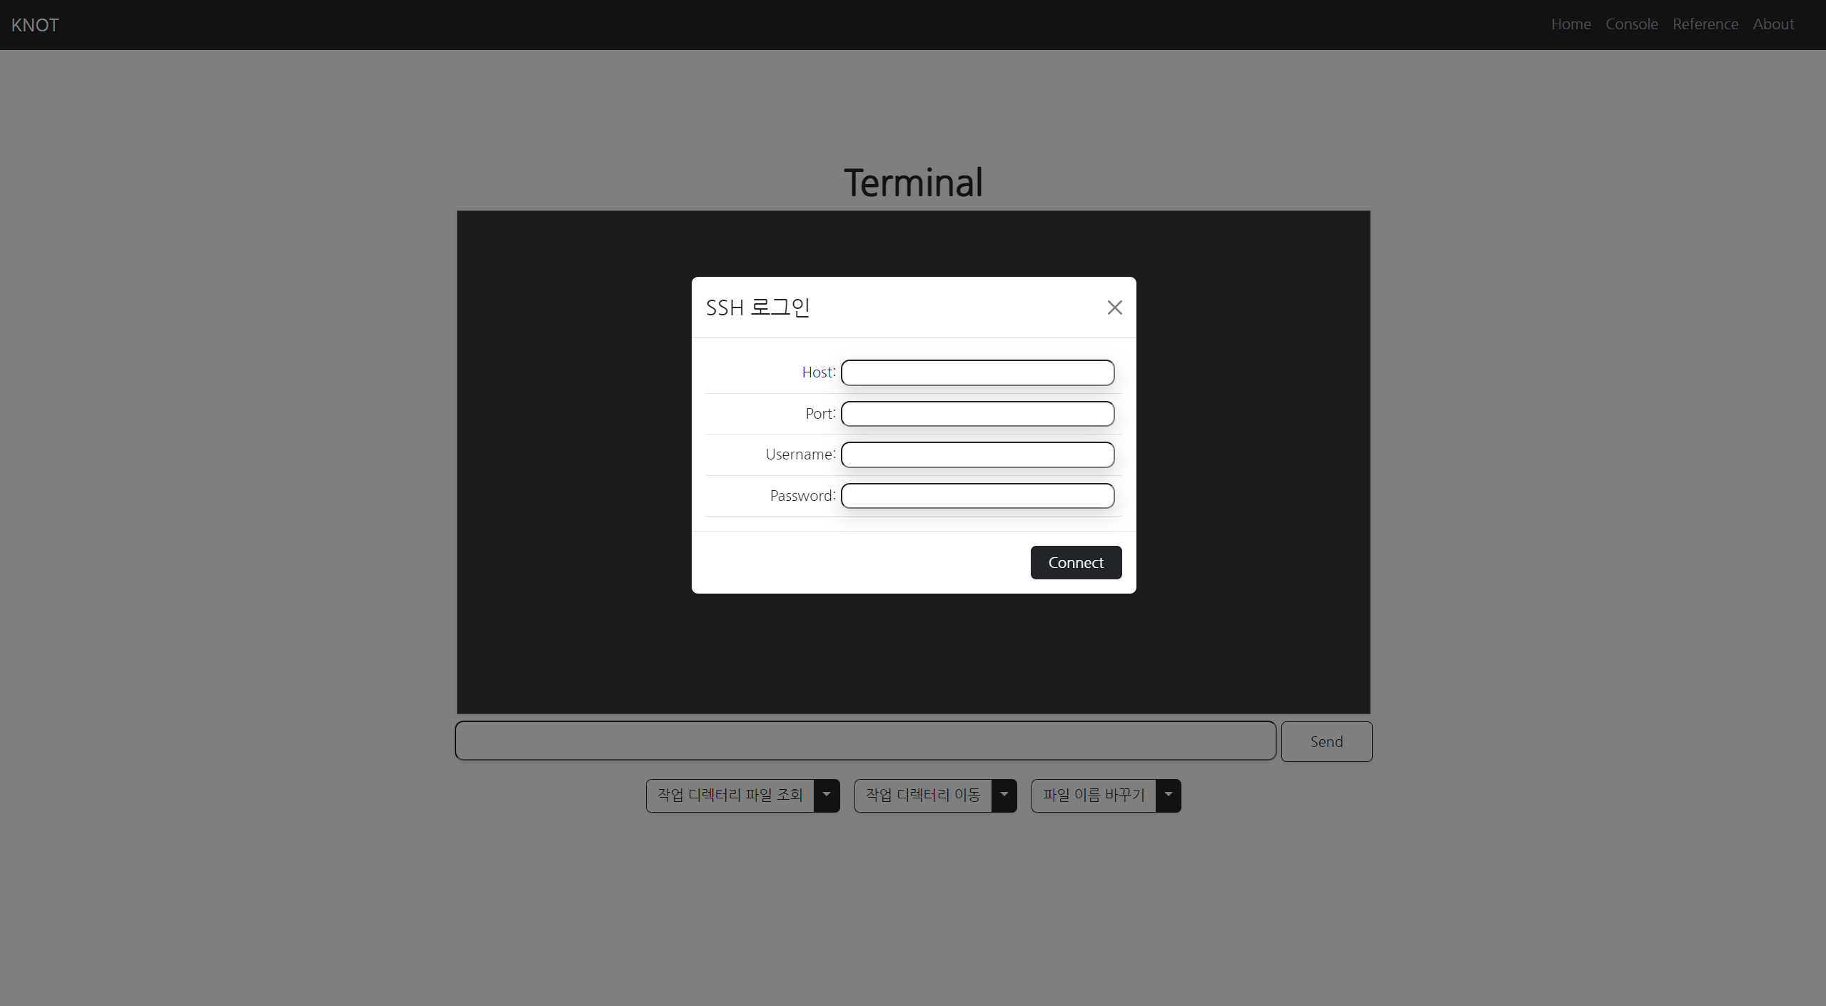
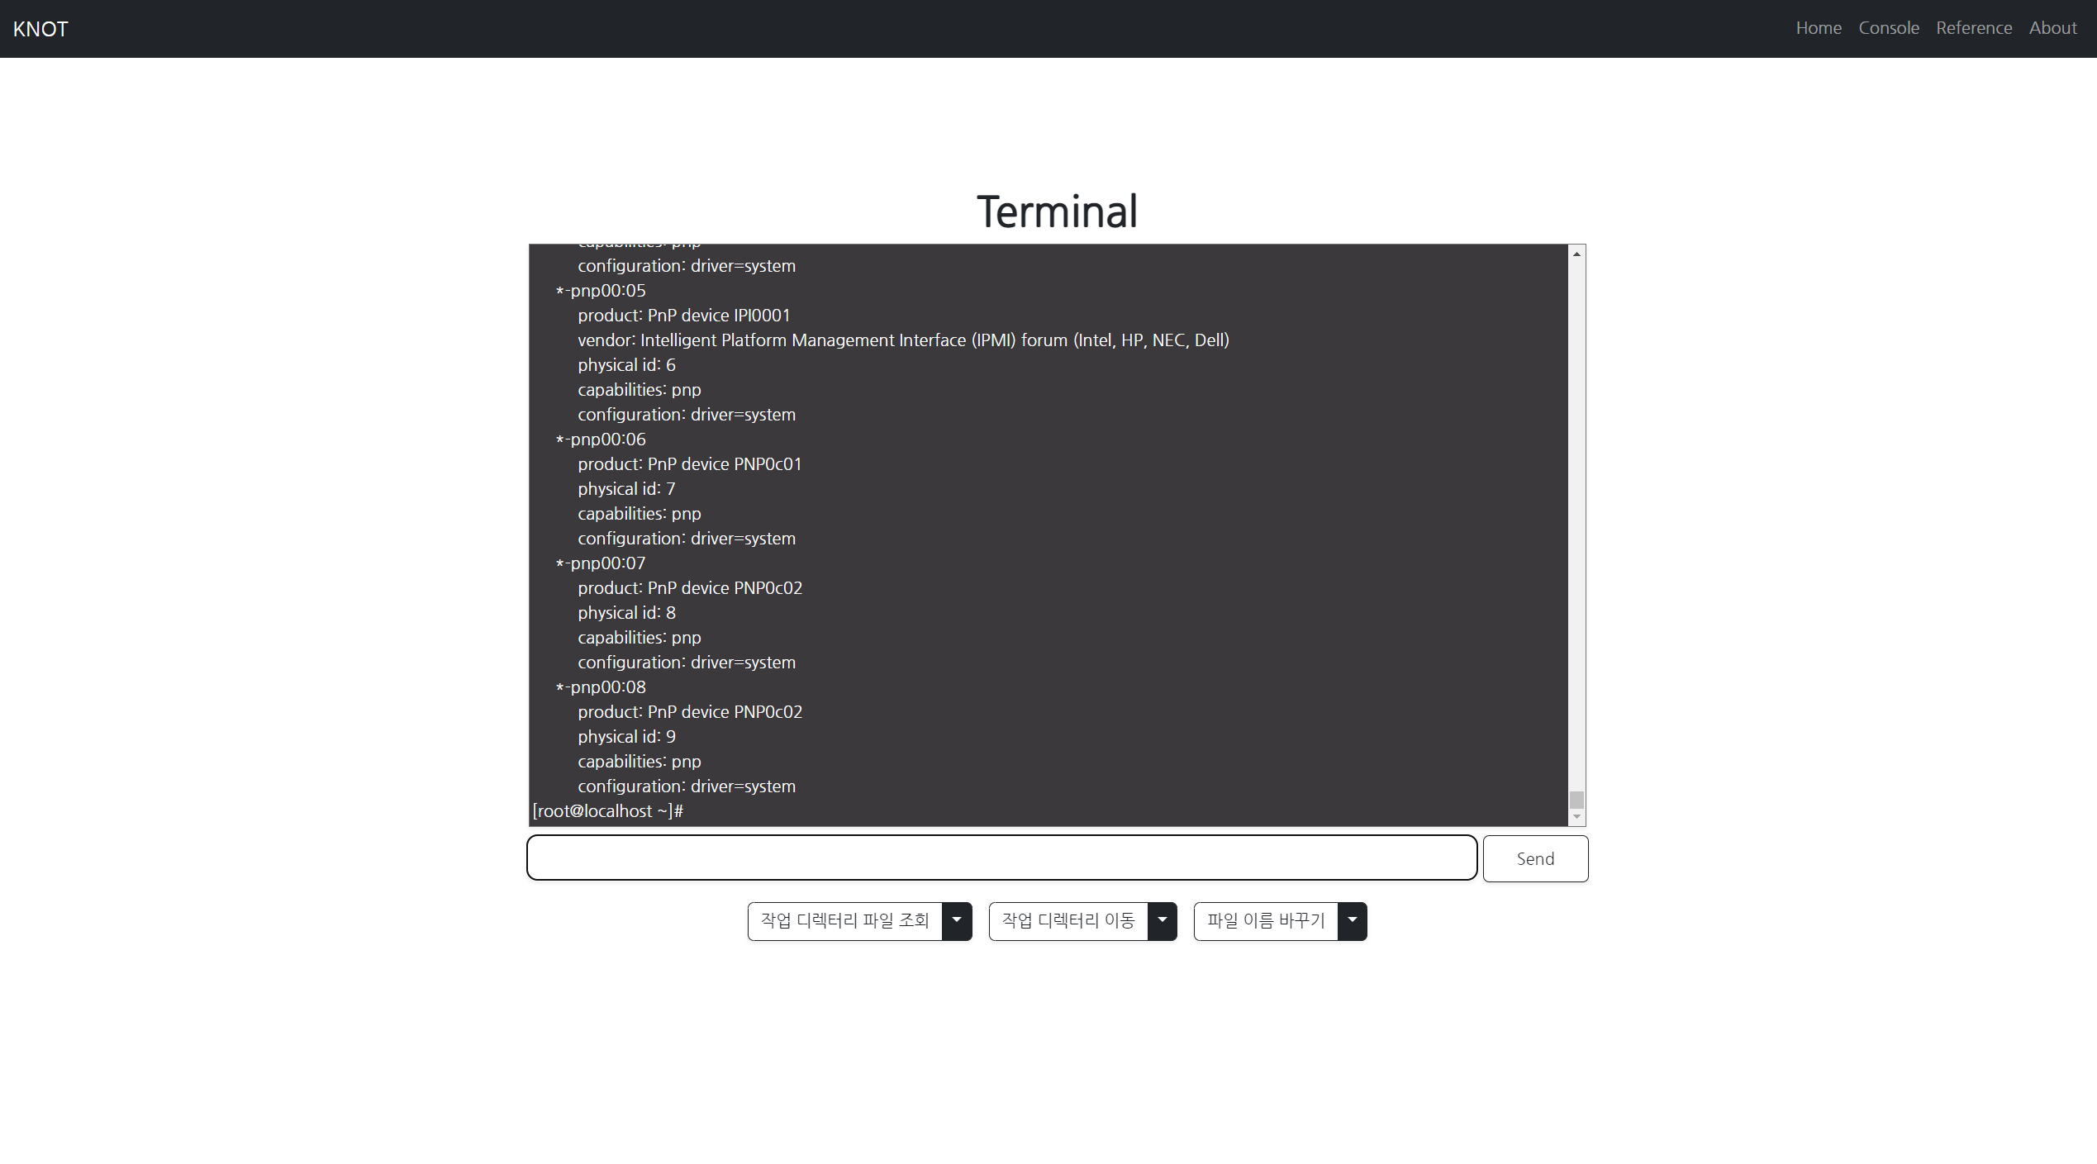
Console
You can type your SSH server address and port, username, password
You can use command via typing or click button

Slide 7
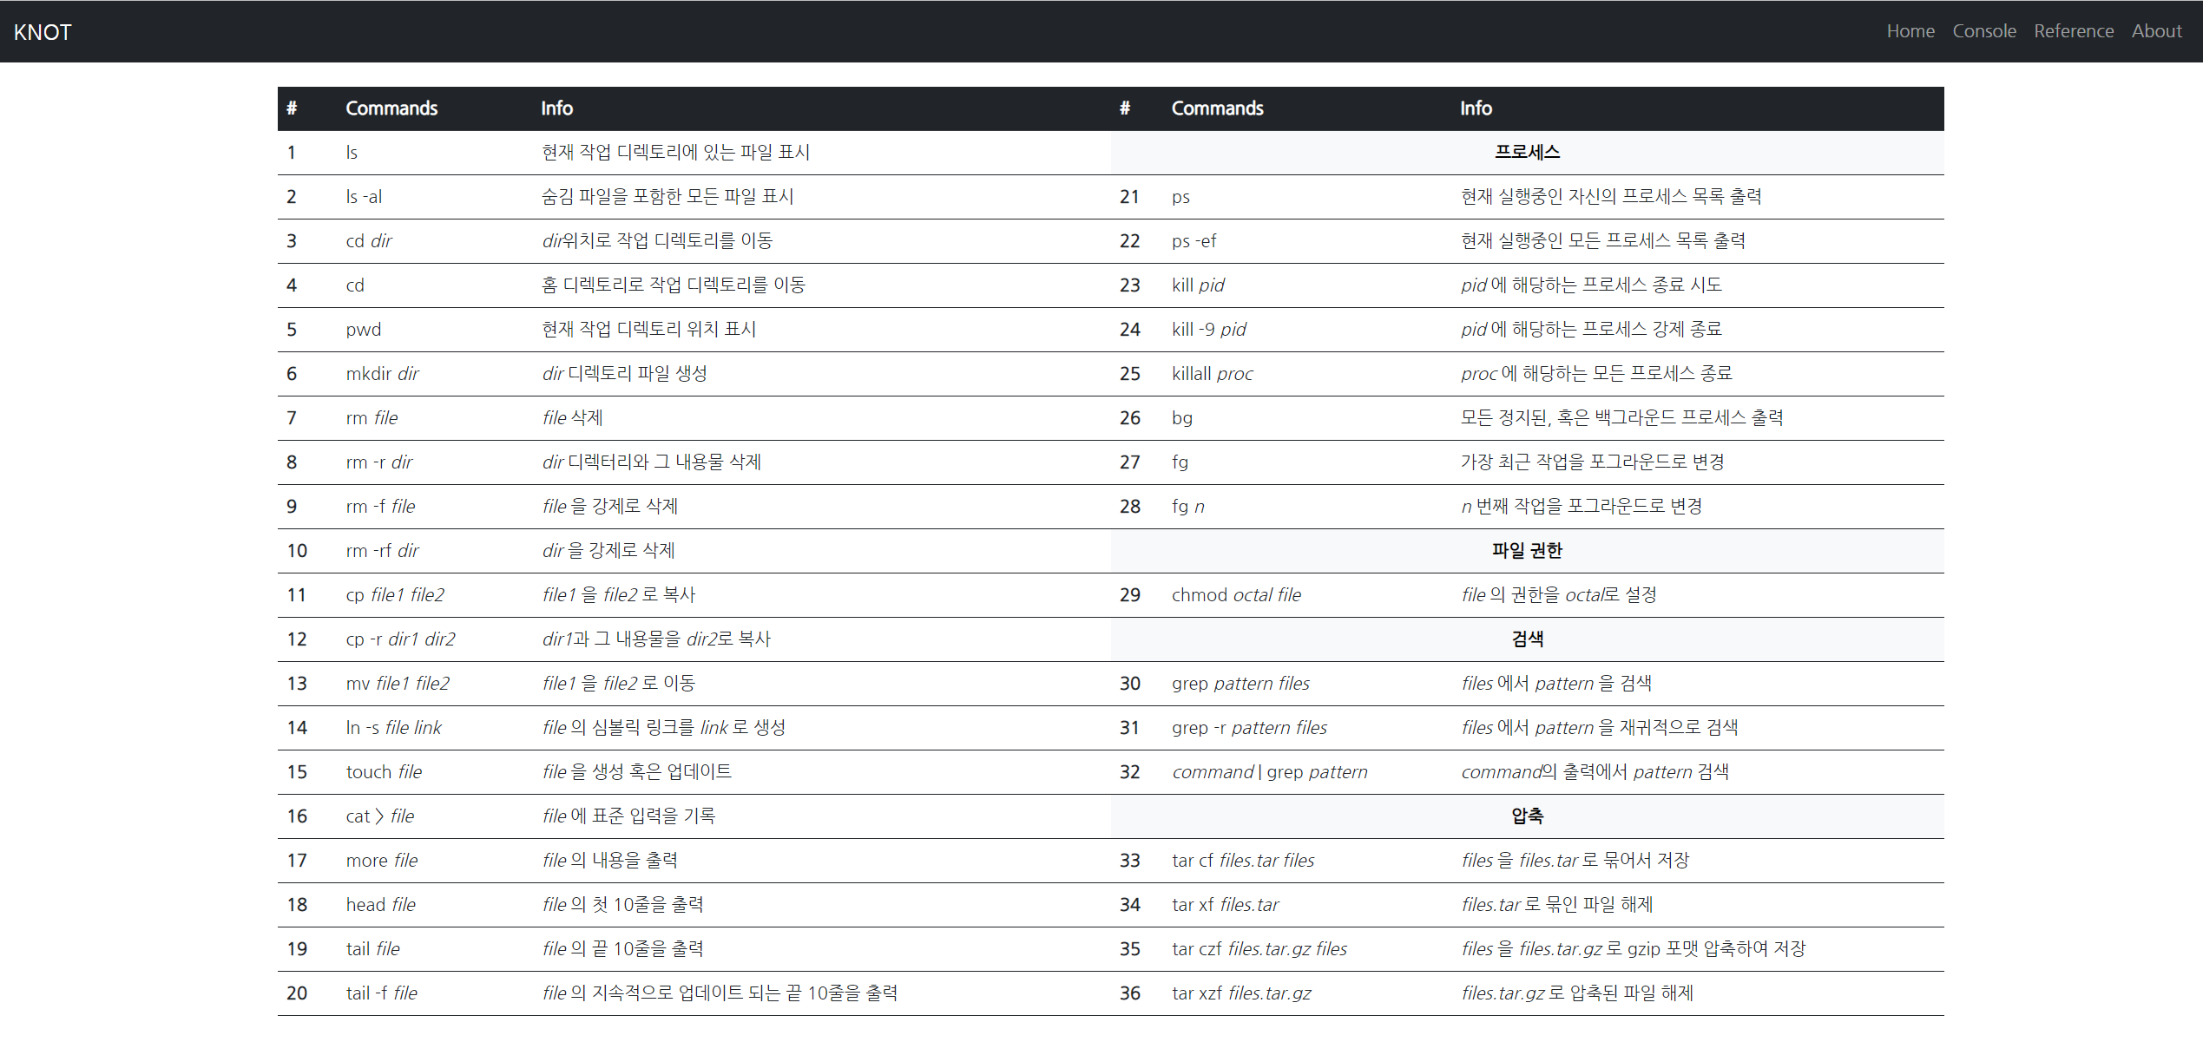
Reference
This shows the basic commands available in Linux. Users can utilize them to access the SSH web console.

Slide 8
About
You can type your SSH server address and port, username, password
You can use command via typing or click button

Slide 9
Our Schedule
Page Design
Implement
Interim Check
Feedback
This is where we are now
Now we need to do

